Slide 1
The mystery of quantity
Ruskin drawing workshop
3rd January 2026
The Guild of St George

Slide 2
Letter 1 sections 72-85
Letter 1 breaks down the difficulty how to proceed from a single leave to an arrangement on a branch. Although designed for the studio or indoors, it is a preparatory step towards working in situ in the landscape.

Slide 3
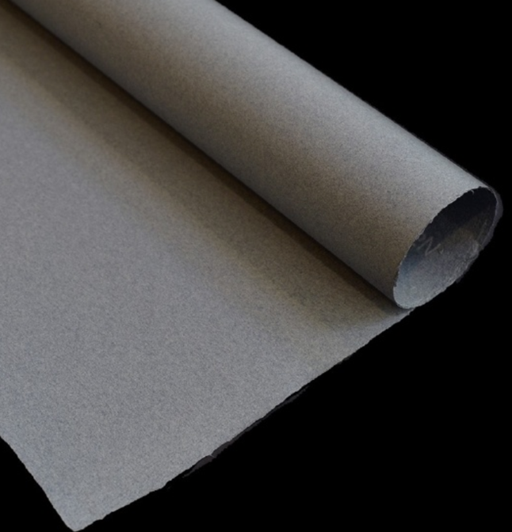
Paper
In Ruskin’s times paper would not be bleached white.
When we look at his drawings now, the paper frequently looks brown or stained- this may be the result of UV light.
Blue paper was liked by Turner, there are also examples of Ruskin using blue paper.
It’s referred to as ‘Turner Blue’ https://store.bookbinding.co.uk/18414/Berlin-Turner-Blue-Laid-110gsm/
For the purpose of the workshop use manila envelopes or Kraft paper, or prepare a paper with a ground of tea, coffee, diluted soya sauce etc.

Slide 4
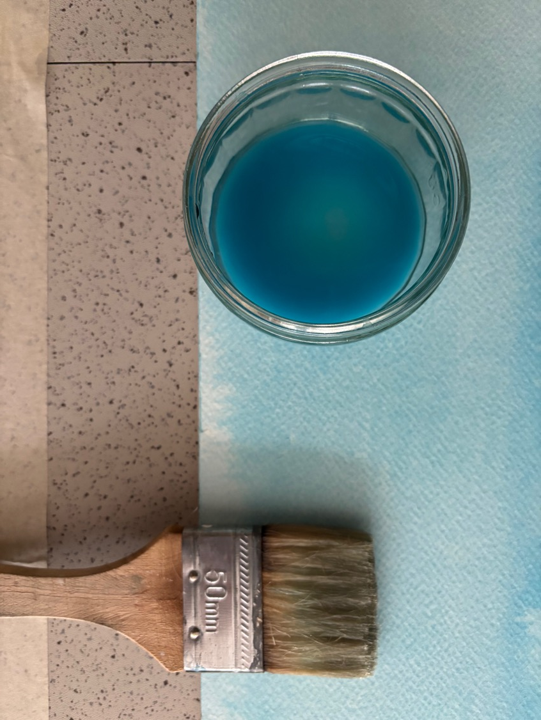
Preparing your paper
Should you like to personalise your paper you can apply a light wash of blue such as cerulean instead. Stretch white paper onto a wooden board, seal with extra wide masking tape all around the paper fixing it to the board and apply the staining agent with a flat 1.5 inch or larger brush. You don’t need to cover the whole paper.

Slide 5
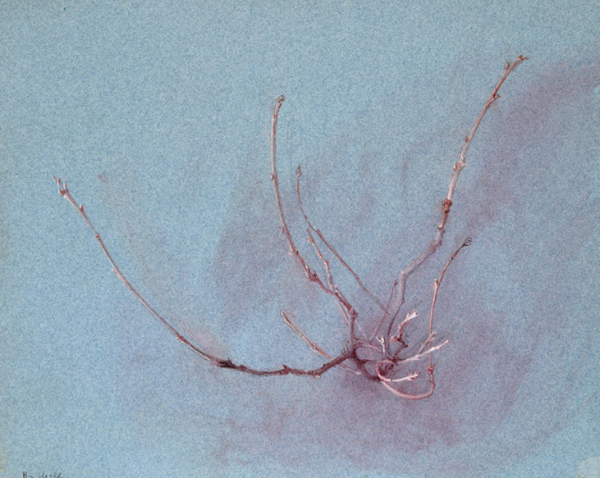
John Ruskin, The Dryad's Waywardness: Oak Spray in Winter, seen in Front 1858–1860 (Ashmolean).
‘Turner Blue Paper’ watercolour and bodycolour over graphite on blue wove paper.

Slide 6
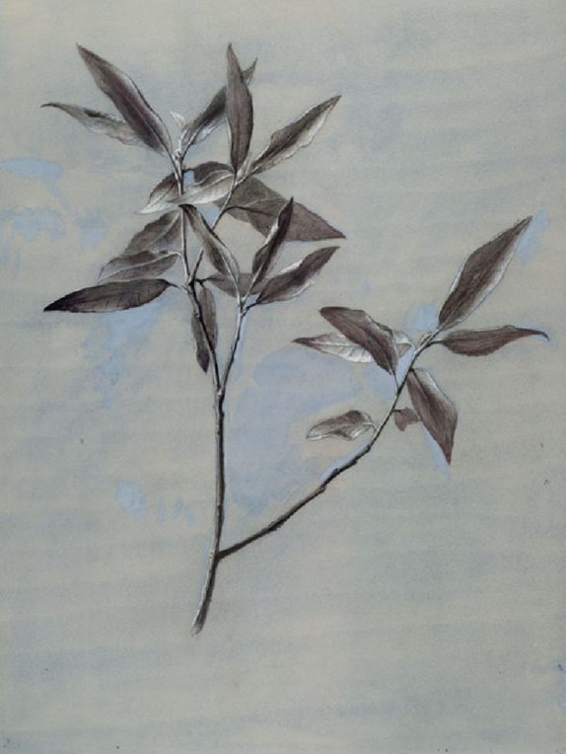
John Ruskin Under-surface of a dried Spray of Olive, gathered at Verona (Ashmolean).
Prepared blue tint on buff grey paper, watercolour and bodycolour over graphite on wove paper.

Slide 7
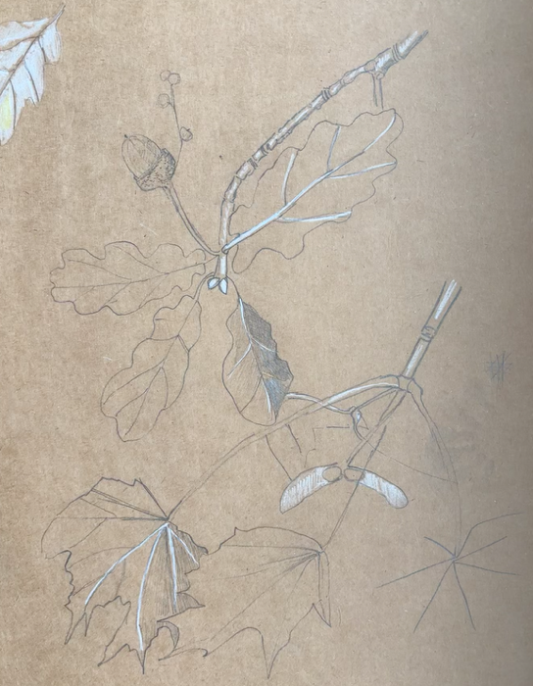
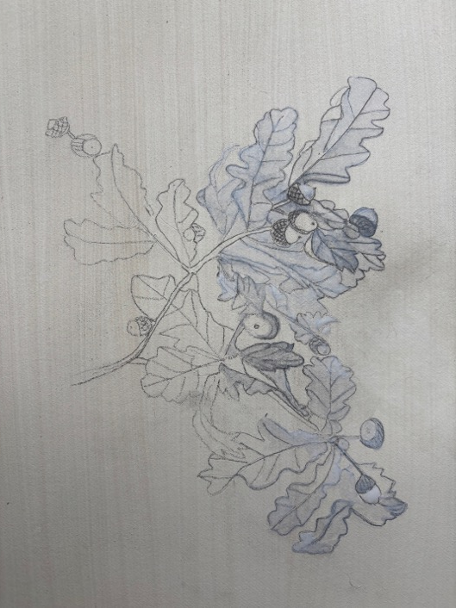
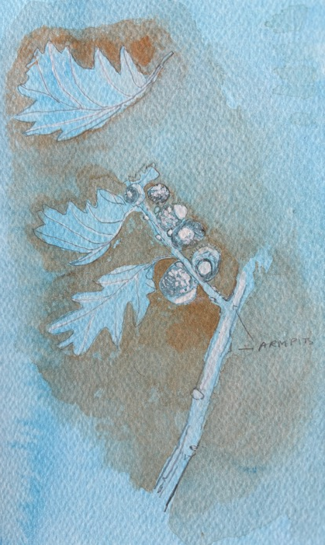
Examples
Doris Rohr pencil and white watercolour on brown card.
Doris Rohr pencil and white paint on prepared gesso ground (tea)
Doris Rohr Cerulean blue ground, pencil and white paint and cadmium red

Slide 8
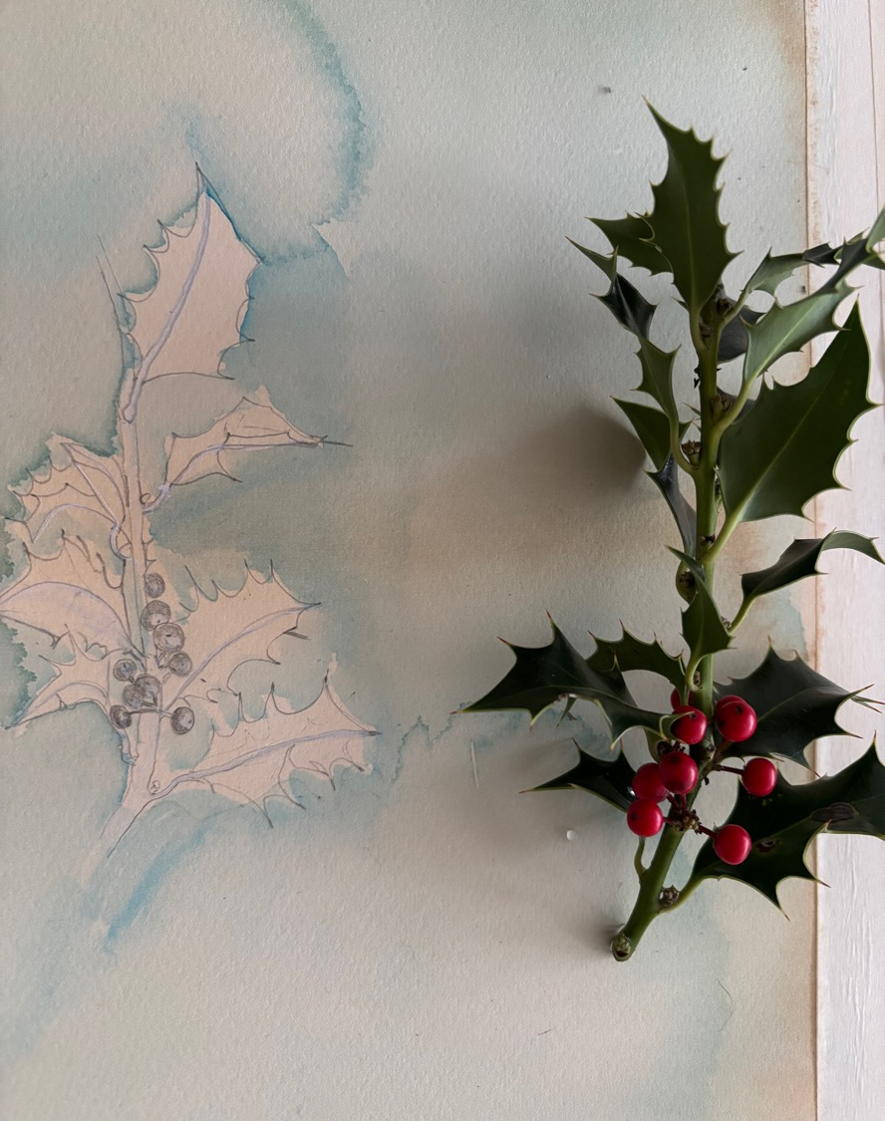
A branch with leaves
We will follow some of Ruskin’s exercises such as:
Partial removal of branches or leaves so one can see the organisation of leaves on stem more easily
The branches for this exercise should not be larger than the paper, Ruskin asks the student to place the branch on the paper and to draw 1:1 scale from it.

Slide 9
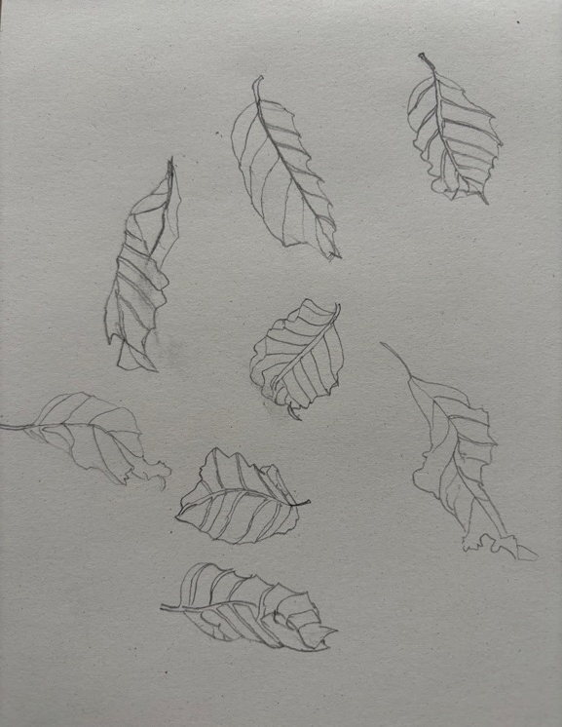
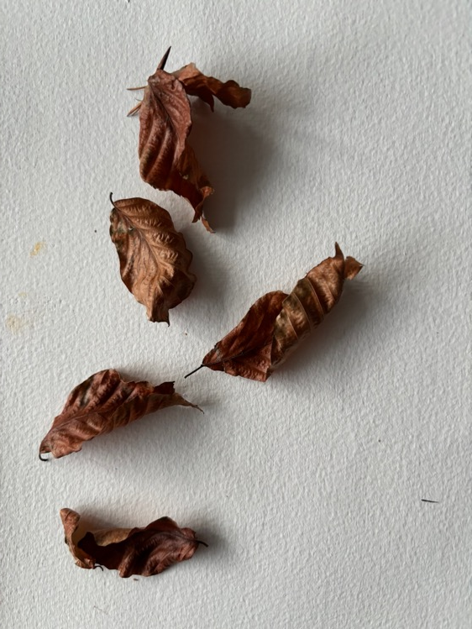
Foreshortening of leaves
Leaf foreshortening is confusing on a branch containing many leaves. Pare it down to one leaf for now, and to draw it in different positions of foreshortening.

Slide 10
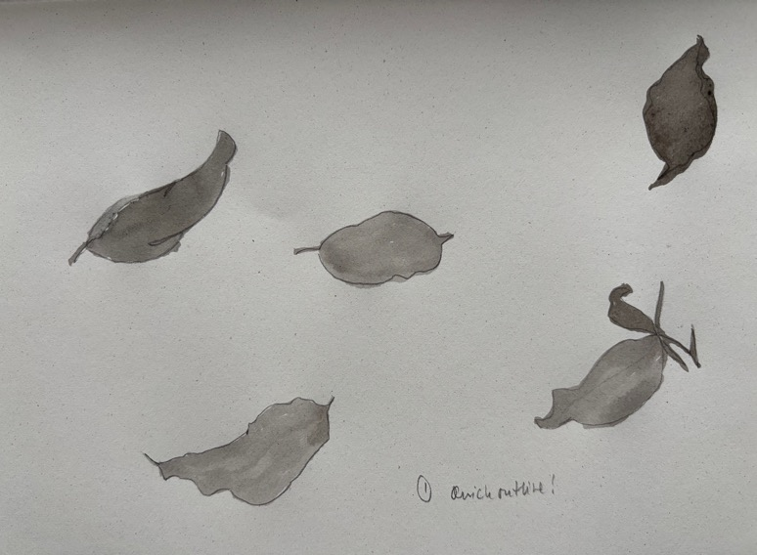
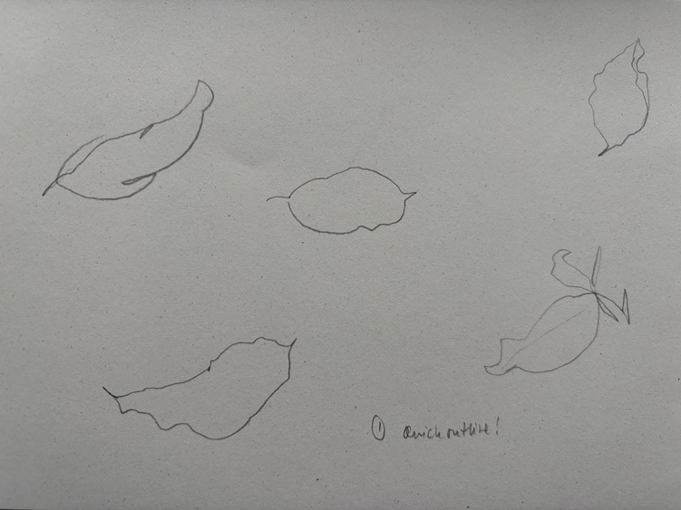
Draw outlines of leaves and stem with pencil then fill in with ink

Slide 11
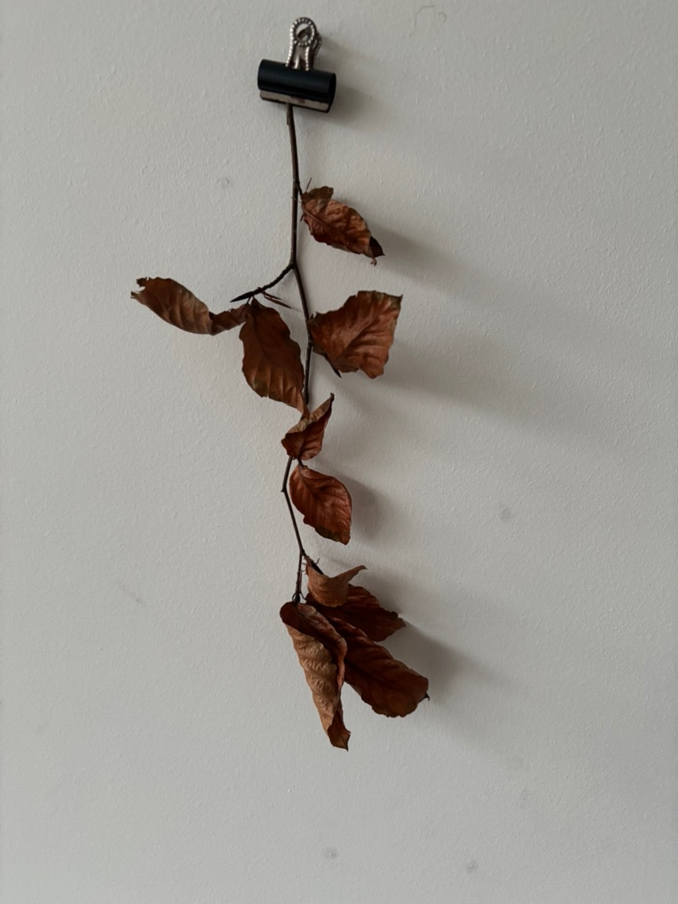
Having placed the branch with leaves against the sheet of white paper or cloth, pinned against a drawing board or wall, the student is to proceed to try and draw the whole branch.
Closing one eye helps to get rid of the double vision of bifocal vision

Slide 12
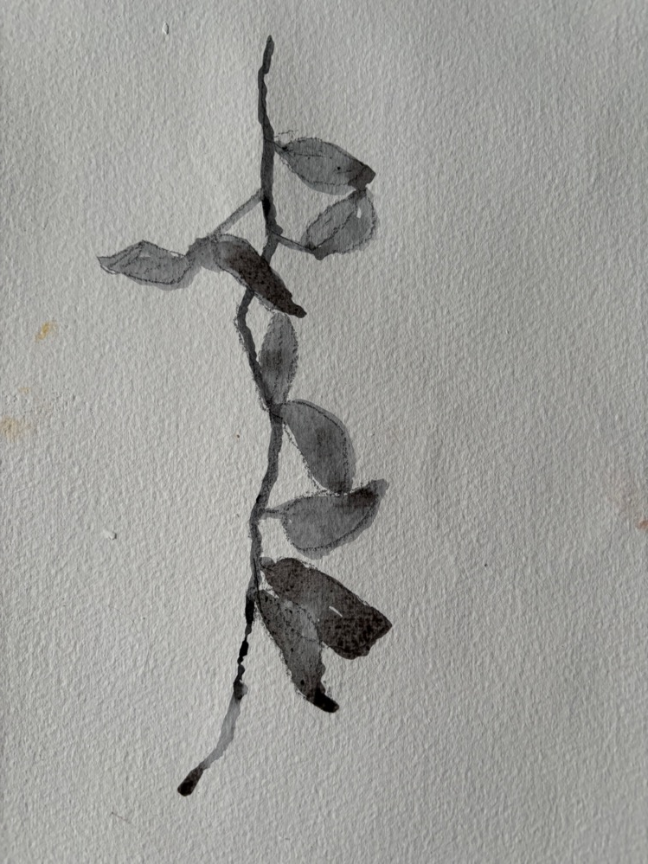


Slide 13
Looking ahead…. Drawing outdoors
Looking ahead to letter 2 where Ruskin speaks about outdoor sketching, he warns against drawing trees from photographs, as these don’t capture the movement of leaves and complexities of branches of a tree in a natural setting.
Drawing in the studio allows to learn about growth structure of plants, and leaves on branches in particular within the controlled environment of a studio where one can regulate lighting to some degree, present less complex situations of shadows and reflections of sky caused by cloud movement or wind, or partial sunshine.

Slide 14
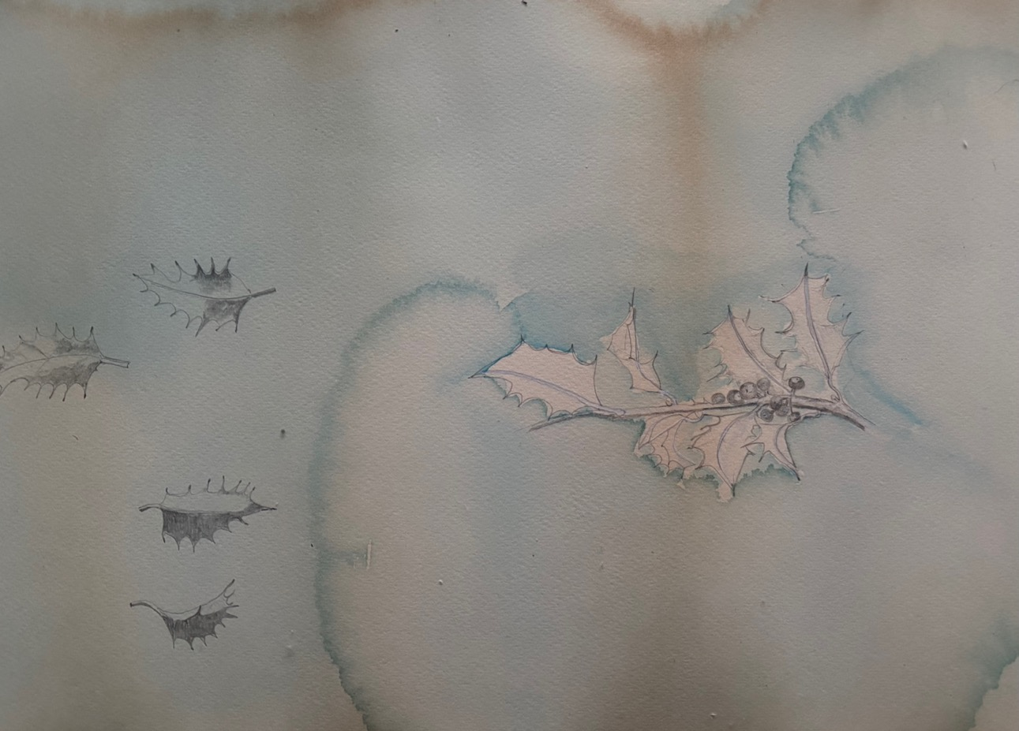
Doris Rohr (2025) Ilex on diluted soya sauce, with a second layer of cerulean blue added after pencil drawing.

Slide 15
Section 85
Ruskin concludes this section by talking about the ‘mystery of quantity’ (section 85).
This may come as a surprise. Ruskin does not advocate slavish detail here. He encourages us to see the bigger picture, paying attention to capture the habit and overall impression of a tree.

Slide 16
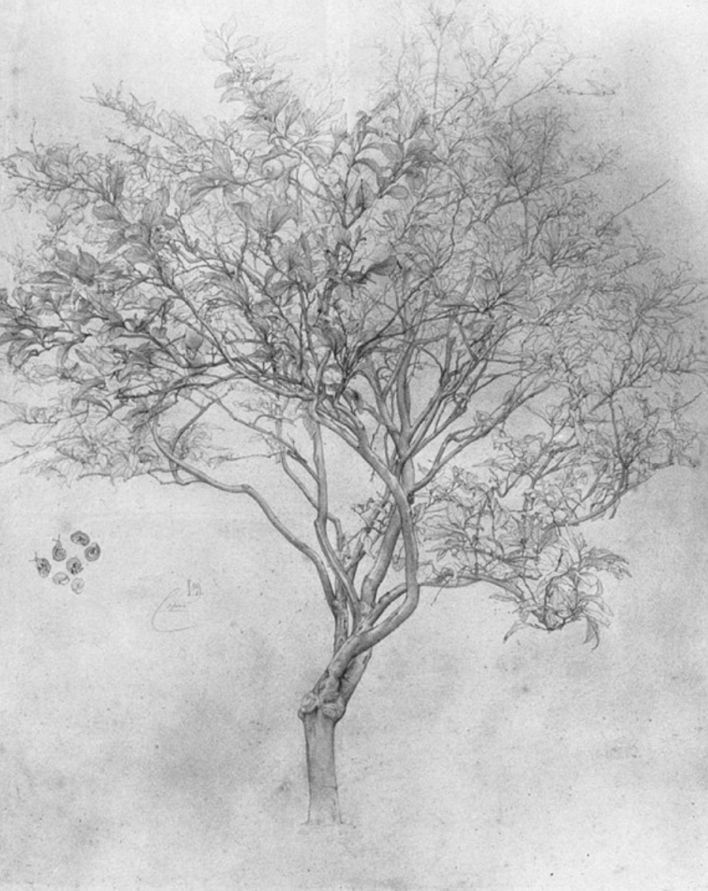
Lord Leighton’s
Lemon Tree
Lord Leighton’s Lemon Tree, marvellous as it is, is not strictly Ruskinian in my view, even though he inspired Leighton to embark on the exercise of drawing a lemon tree over the period of a week! https://gurneyjourney.blogspot.com/2008/04/leightons-lemon-tree.html
Ruskin liked it nevertheless, and perhaps one needs to embrace to contradictions here.

Slide 17
Conclusions…
In summary then Ruskin wants us to learn the growth structures and patterns of a branch/ tree so in some ways this is learning from the pebble to the mountain all over again, yet different, as he wants the learner to grasp the overall total effect of a tree. To get the overall ‘feel’ or habit of a tree shape right requires an unquantifiable aspect, which is a mystery of nature, the mystery of quantity. This may be tested when proceeding to letter 2 on outdoor excursions.

Slide 18
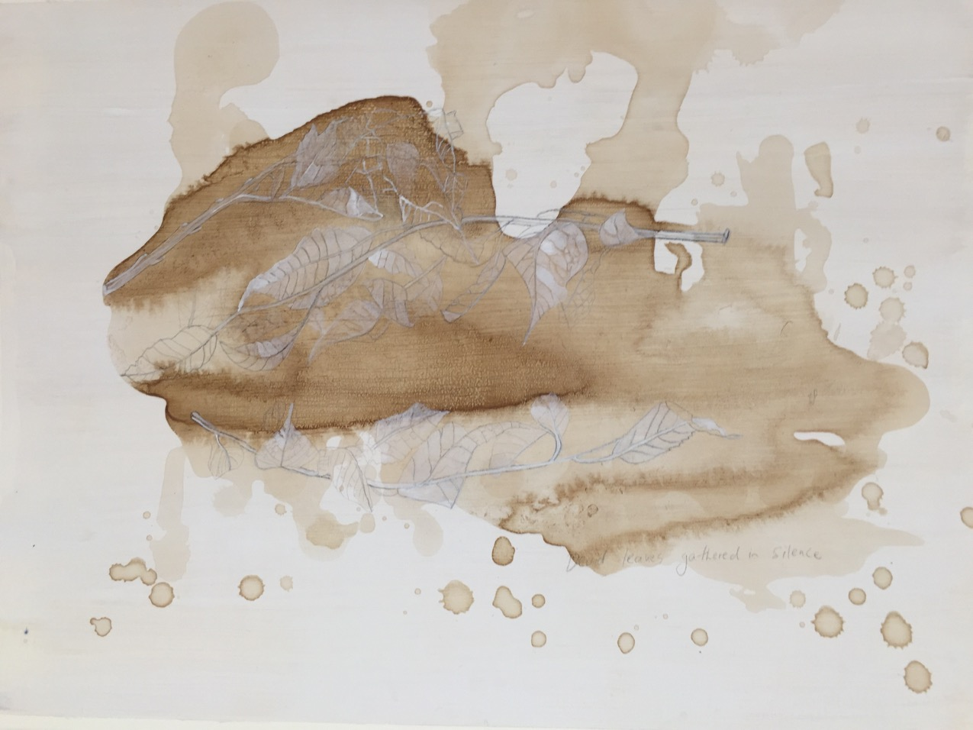
Rohr (2023) ‘Leaves gathered in silence’ (Yeats) tea, white gouache, pencil, silverpoint, silver.

Slide 19
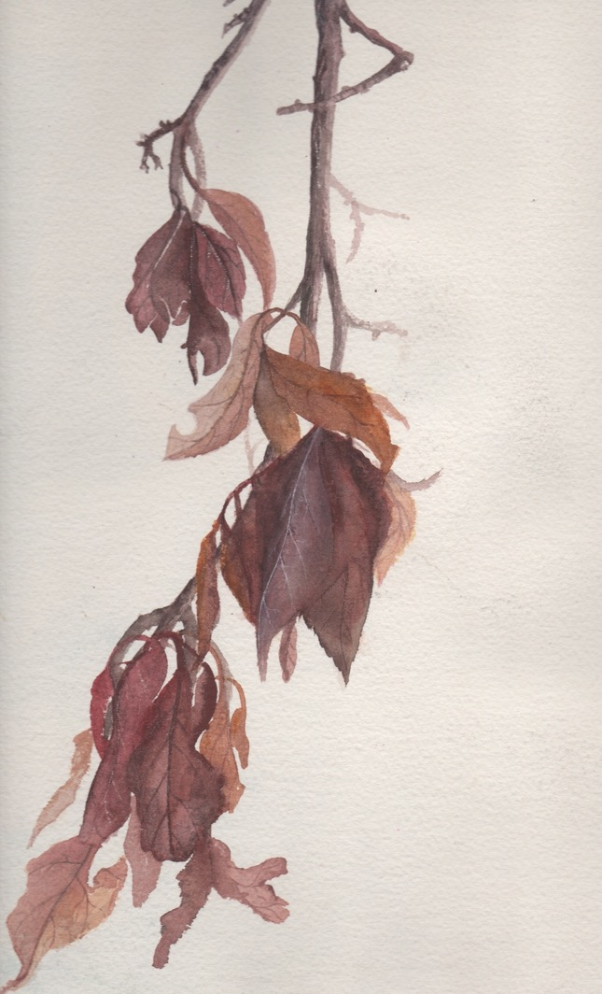
Aiming to…
… resolve the mystery of quantity.
This is an early drawing when I was a late teenager and had a steady hand.
Learning to embrace changes in our physical ability, that the eyesight is no longer what it once was, is part of it.
The key is to see the beauty in a withered prunus branch.
Doris Rohr Withered Prunus Branch circa 1983/4

